Slide 1

Decentralized Energy Marketplace: Powering a Sustainable Future
Discover how decentralized energy marketplaces are transforming the energy sector. Learn about their benefits and real-world applications. Explore how they contribute to a sustainable future.

Slide 2
The Current Energy Landscape: Challenges and Inefficiencies
The traditional energy system faces several challenges. Inefficiencies in transmission and distribution are widespread. Dependence on centralized power plants limits flexibility. Outdated infrastructure needs modernization.
Centralized Grids
Fossil Fuels
High transmission losses reduce efficiency.
Contribute to climate change and air pollution.

Slide 3
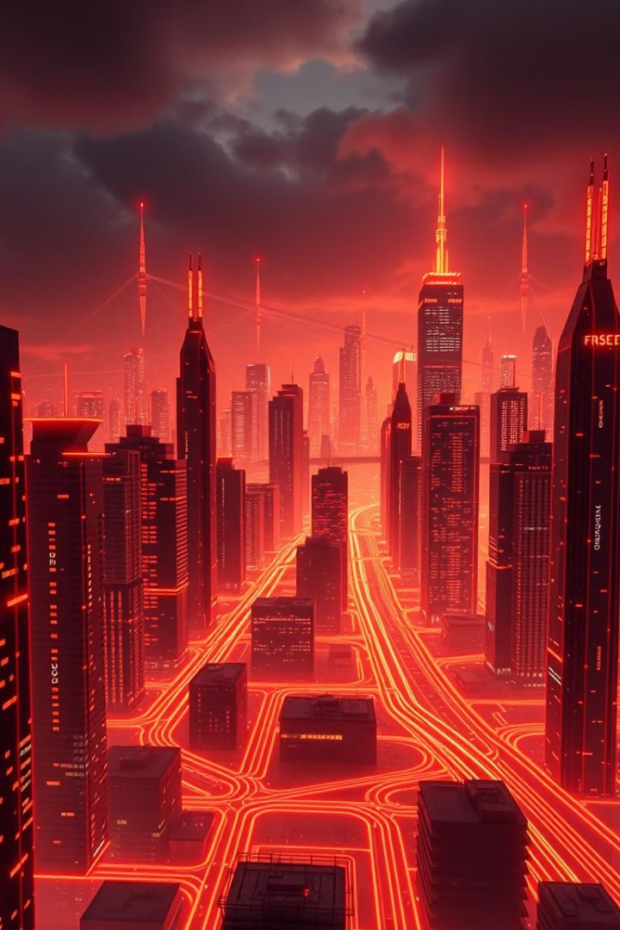



What is a Decentralized Energy Marketplace? Key Concepts Explained
A decentralized energy marketplace allows local energy generation. Peer-to-peer trading becomes possible. Smart contracts automate transactions. Blockchain technology ensures transparency.
Local Generation
Renewable energy sources like solar and wind.
Peer-to-Peer Trading
Direct energy exchange between users.
Smart Contracts
Automated and secure transactions.

Slide 4
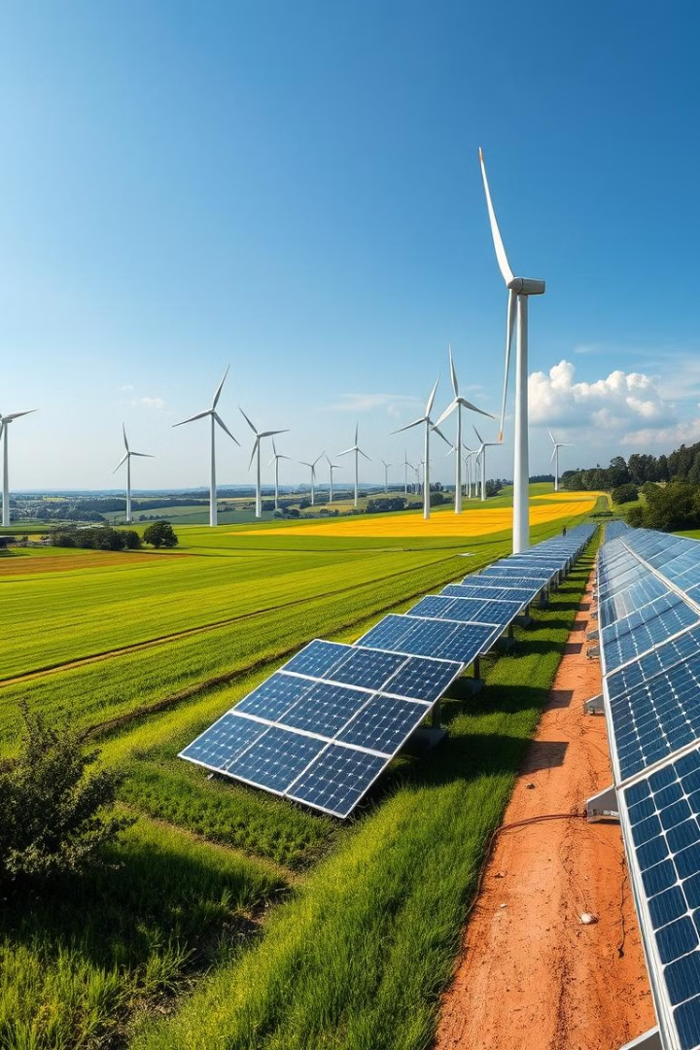
Benefits of Decentralized Energy: Lower Costs, Increased Resilience, and Sustainability
Decentralized energy offers numerous advantages. It reduces energy costs for consumers. It improves grid resilience against disruptions. It promotes sustainability through renewable sources.
Cost Savings
Grid Resilience
Reduced transmission costs.
Distributed energy sources increase grid stability.
Sustainability
Reduced reliance on fossil fuels.

Slide 5



Real-World Examples: Success Stories of Decentralized Energy Marketplaces
Several successful decentralized energy marketplaces exist. Brooklyn Microgrid enables local energy trading. Piclo Flex optimizes grid flexibility in the UK. These projects demonstrate the potential of decentralized energy.
Brooklyn Microgrid
Piclo Flex
Local energy trading in New York.
Grid flexibility optimization in the UK.

Slide 6
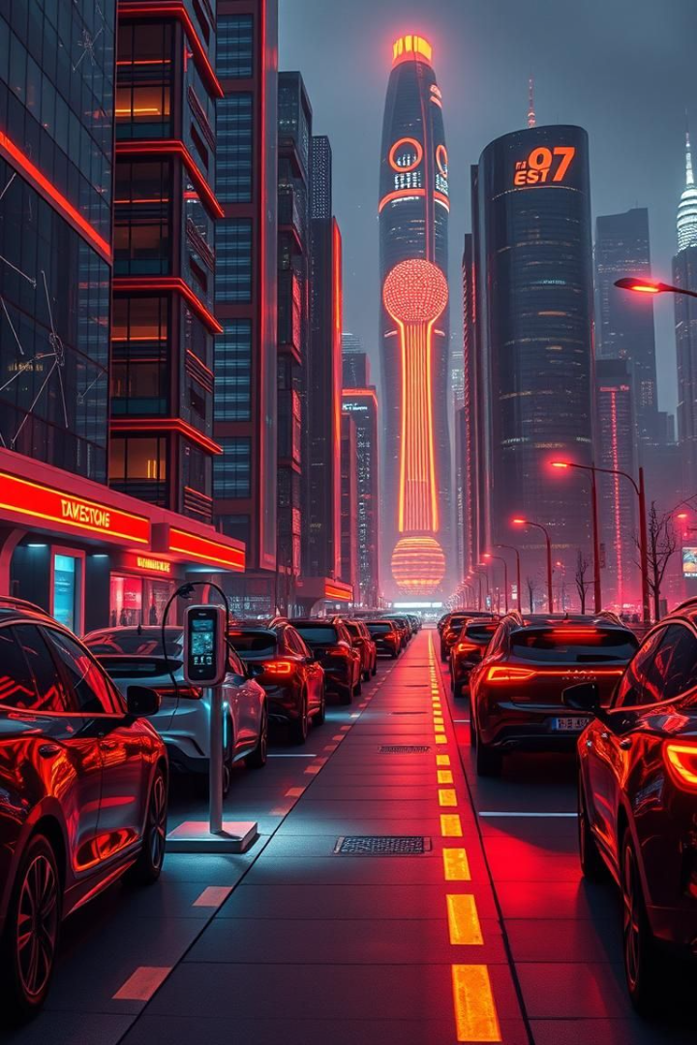
The Future of Energy: How Decentralization Will Transform the Grid
Decentralization will reshape the future of energy. Smart grids will integrate distributed resources. Electric vehicles will play a key role. Microgrids will enhance local energy independence.
1
Smart Grids
Integration of distributed resources.
2
Electric Vehicles
Participate in grid services.
3
Microgrids
Enhanced local energy independence.

